Slide 1
Android Final Project – Scientific calculator
王偉斌 107590050
陳小蘭 107590058

Slide 2
Contents
Introduction
Functions
User Interface

Slide 3
Introduction
The Free Calculator simplifies your life and multiplies your opportunities. For work & school at home. A basic calculator and a scientific mode for more extensive math. The Free Calculator simplifies your life and multiplies your opportunities!
Feature
The Free Calculator simplifies your life and multiplies your opportunities. For work & school at home. A basic calculator and a scientific mode for more extensive math. The Free Calculator simplifies your life and multiplies your opportunities!

Slide 4
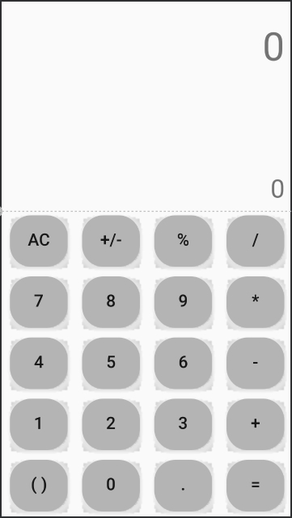
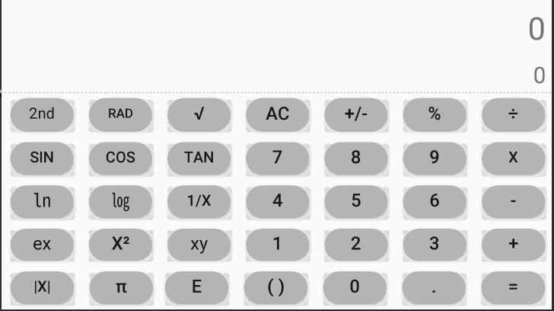
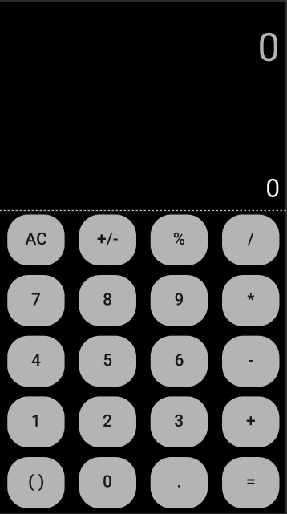
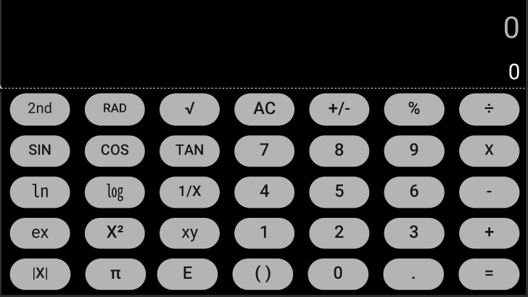
User Interface
Day Mode
Night Mode

Slide 5
Functions
Addition, Subtraction, Division, Multiplication, Percentages
Square, Cubic Exponent, Nth Exponent
Square Root, Cubic Root, Nth Root
Engineering Exponent, Factorial
Power of Two, Power of Ten, Power of E
Natural Logarithm, Common Logarithm, Binary Logarithm
Sine, Cosine, Tangent
Arc Sine, Arc Cosine, Arc Tangent
Hyperbolic Sine, Hyperbolic Cosine, Hyperbolic Tangent
Hyperbolic Arc Sine, Hyperbolic Arc Cosine, Hyperbolic Arc Tangent

